Slide 1
MED MONITOR Project
EN3251 IoT Course Project
Group 16

Slide 2
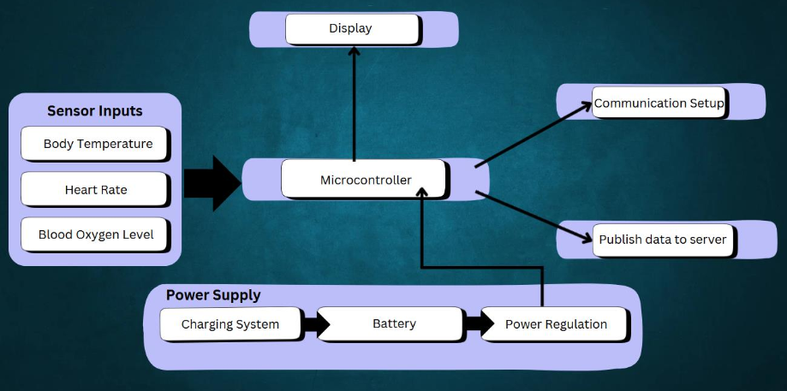
Functional Block Diagram

Slide 3
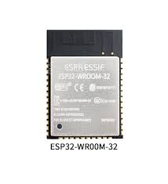
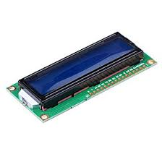
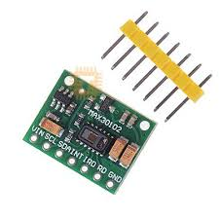
Main Components in the Circuit
16*2 LCD Display
MAX30102 Sensor

Slide 4
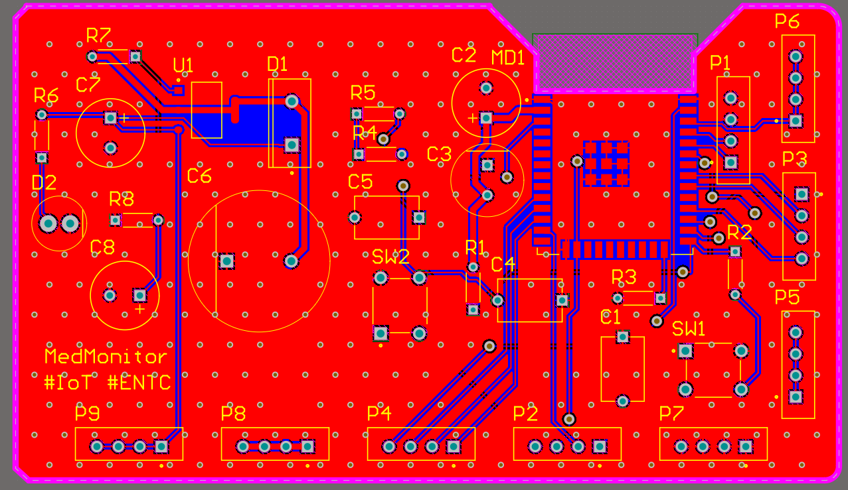
PCB Design

Slide 5
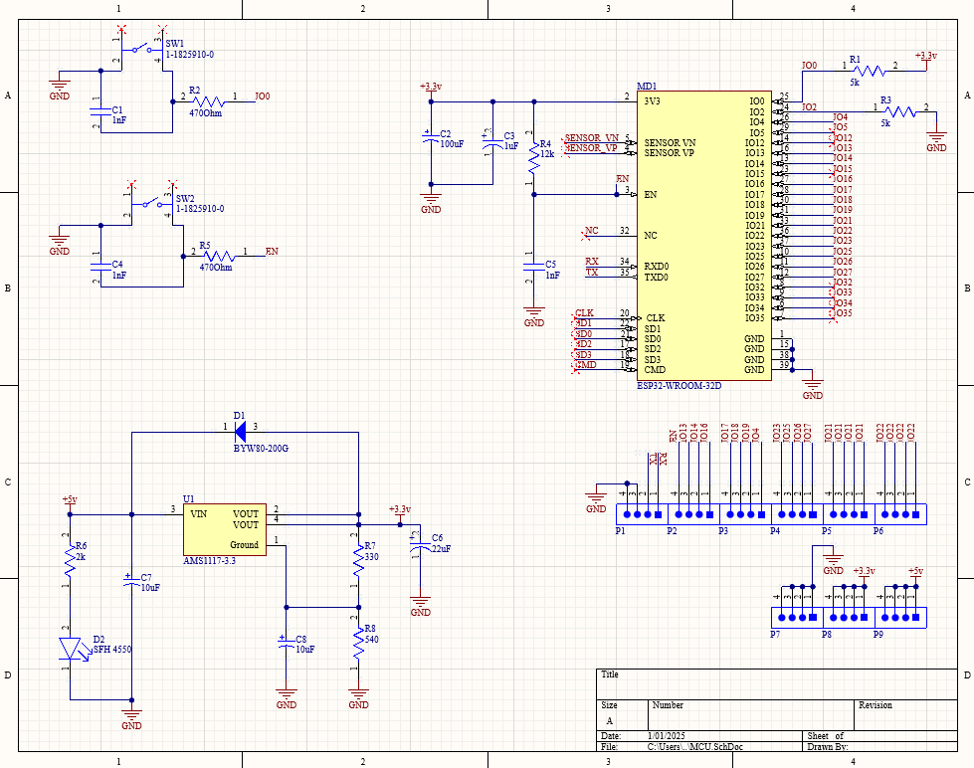
Schematic Design

Slide 6
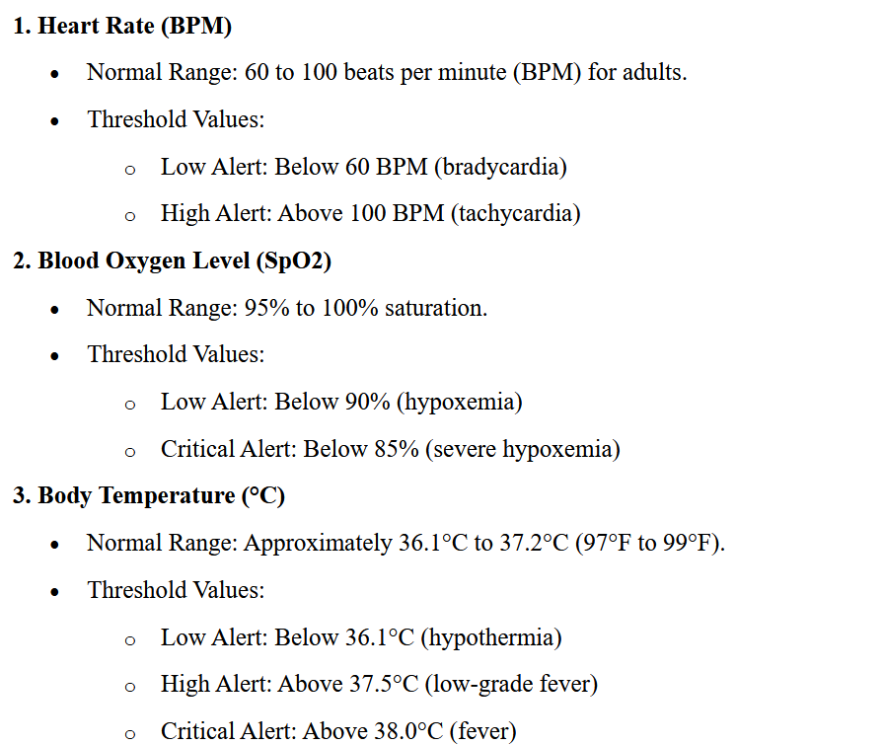
Threshold Values

Slide 7
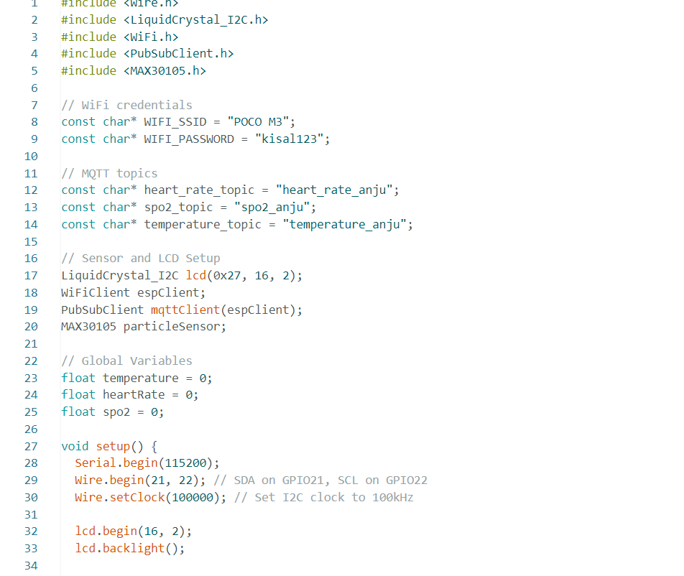
Code Work

Slide 8
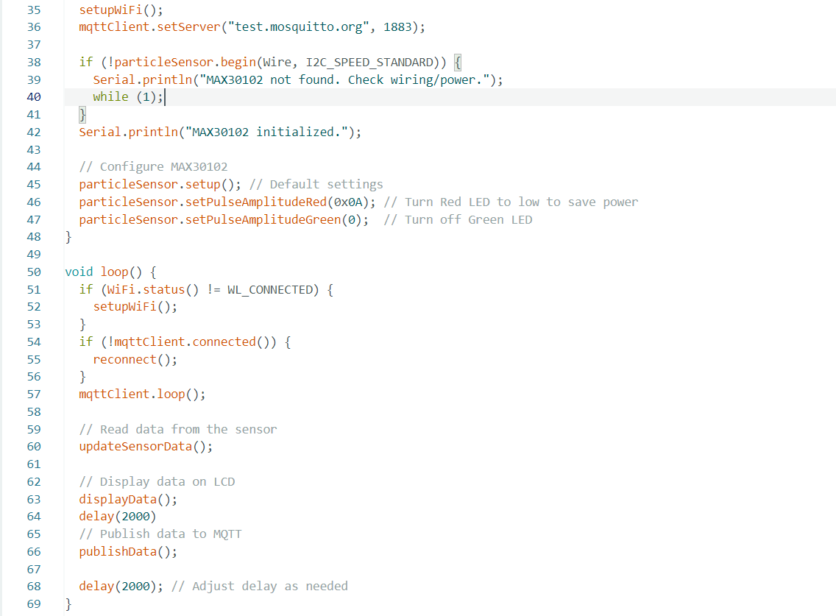

Slide 9
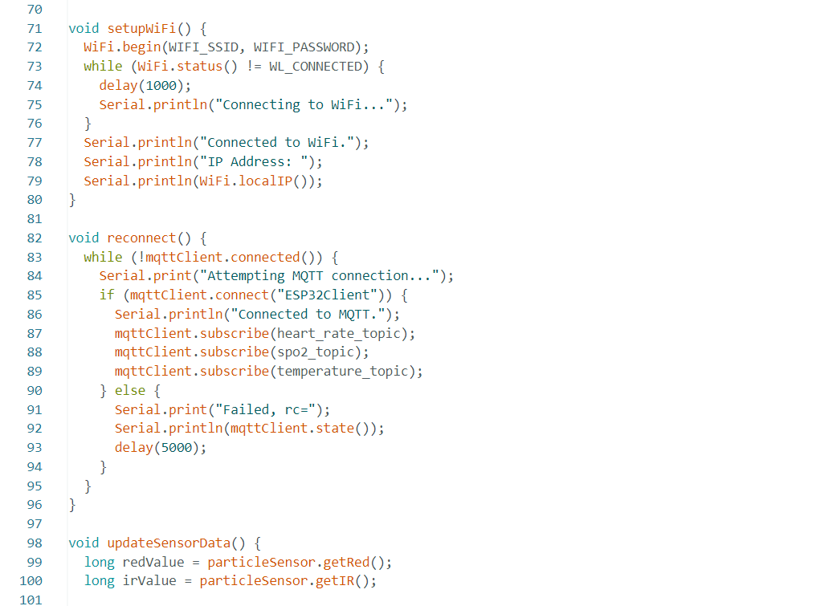

Slide 10
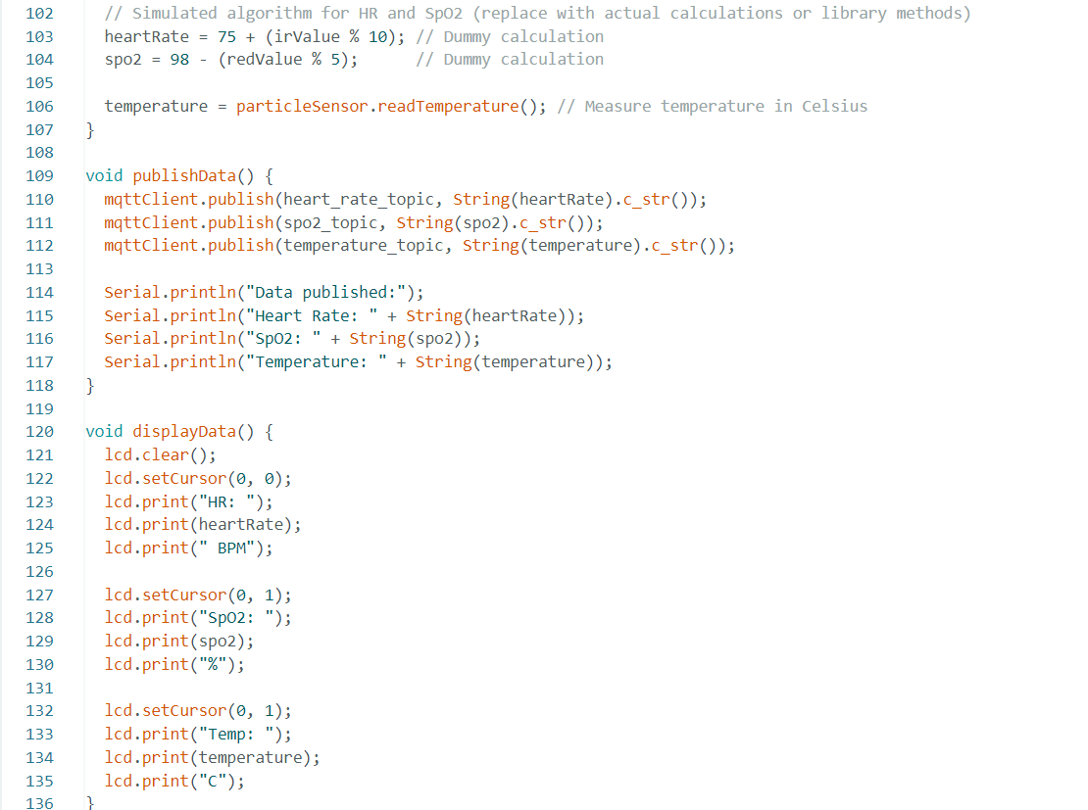

Slide 11
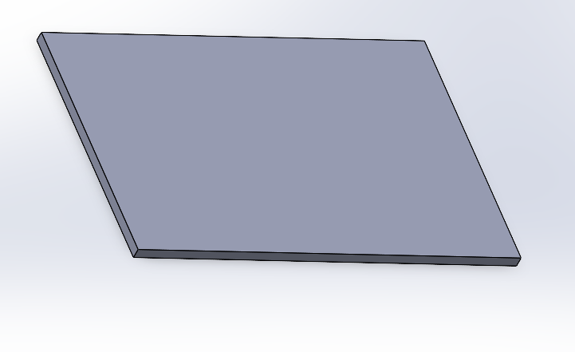
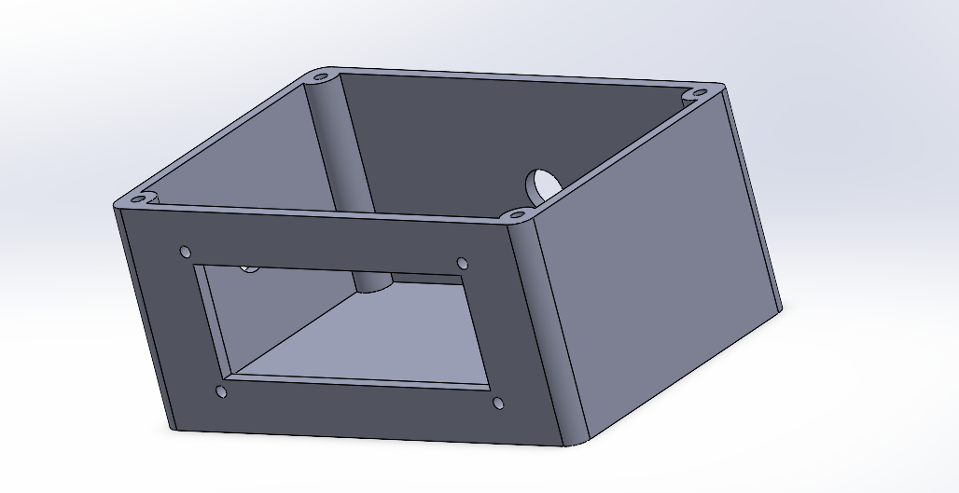
Enclosure Design

Slide 12



Group Members
M.K.Anjula
Kisal Thennakoon
Avinda Shamal

Slide 13

Thank You!

